Slide 1
Ontology based recognition of hasta mudras in Bharatanatyam dance
Aryan Agarwal (19CS30005)
Under supervision of Prof. Partha Pratim Das

Slide 2
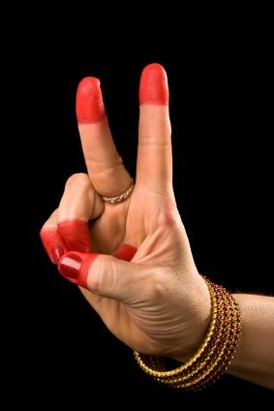
Overview
Introduction
Ontology Based Recognition
Related Works
Conclusion

Slide 3
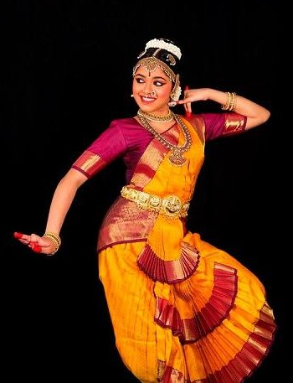
Introduction : What is Bharatanatyam?
Form of Indian Classical Dance.
Originated is south India.
Comprises of a solo dancer.
Dancer performs various Hastha mudras.

Slide 4
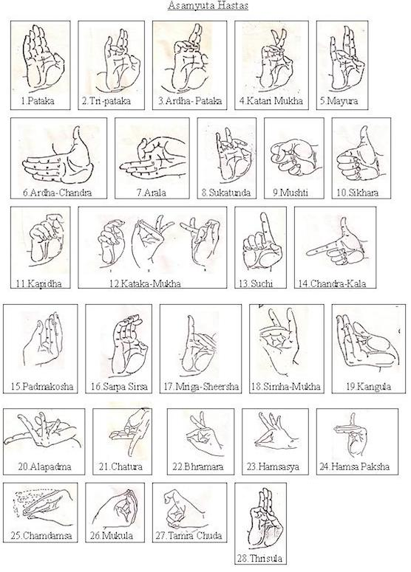
Hastha mudras are of 2 types:-
Single Hand Gestures
Double Hand Gestures
Dancer conveys the ras and bhava.

Slide 5
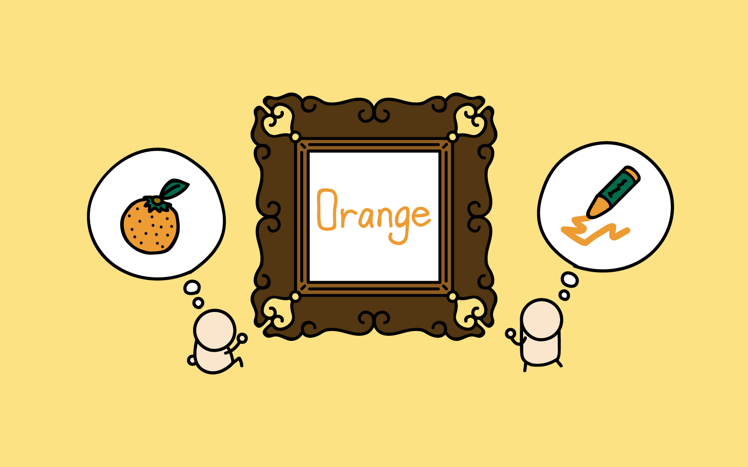
Introduction : What is Ontology?
Simply put Ontology is the ‘nature of being’
“what we mean when we say what we say”.

Slide 6
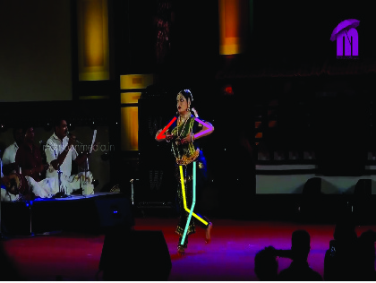
Motivation : Why Ontology of Hastha Mudras?
In my BTP project, we will create a Bharatanatyam Hastha mudra ontology and try to recognise those Bharatanatyam hastha mudra using Ontology.
Ontology, which can help us extend the Ontology to other dance gestures in future.

Slide 7
Computer vision is a fastly growing topic of research. Interaction of humans with computers is not just limited with keyboards and mouse.
We now have AR/VR headsets and joysticks to play games, interact with each other on the metaverse or even do complex surgeries.

Slide 8
Related Work
An Ontology for Reasoning on Body-based Gestures. [1]
Jean Vanderdonckt et al. made an ontology for structuring body-based gestures based on the user body and body parts, gestures and environment.
Notes:
Body-based gestures, such as acquired by Kinect sensor, today benefit from efficient tools for their recognition and development, but less for automated reasoning. To facilitate this activity, an ontology for structuring body-based gestures, based on user, body and body parts, gestures, and environment, is designed and encoded in Ontology Web Language according to modelling triples ⟨subject, predicate, object⟩. As a proof-of-concept and to feed this ontology, a gesture elicitation study collected 24 participants × 19 referents for IoT tasks = 456 elicited body-based gestures, which were classified and expressed according to the ontology.

Slide 9
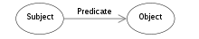
Ontology For Body-Based Gestures
An ontology was designed to represent the body-based gestures. The user, sensor and the physical environment were expressed in the Ontology Web Language using RDF triples.
The format of triples was <subject,predicate,object>

Slide 10
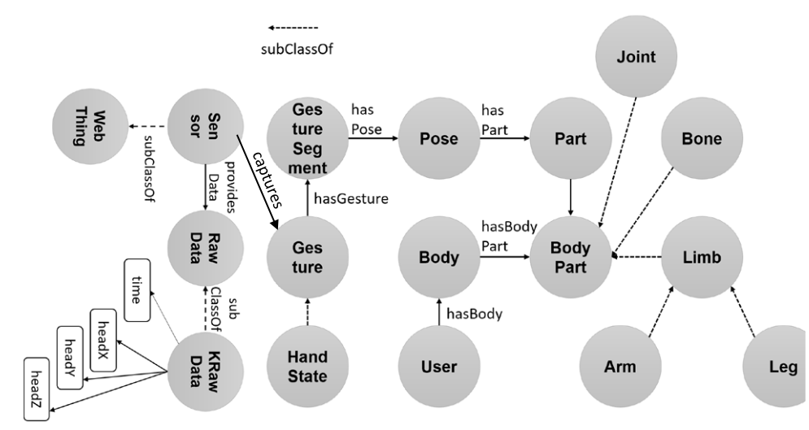
Figure : The ontology for body-based gestures.
Some main classes:-
User
Sensor
Detected gestures and poses

Slide 11
Gesture
A gesture is made up of strokes that are binding points. We can define a gesture by connecting these points.
A sensor captures the gesture as tuple of 5 elements, p_{i}=(x_{i},y_{i},z_{i},w_{i},t_{i}) , where the last element represents the time and the first 4 are the 4D coordinates of each gesture point.
Notes:
Stroke : a mark made by drawing a pen, pencil, or paintbrush in one direction across paper or canvas.
"the paint had been applied in careful, regular strokes"

Slide 12
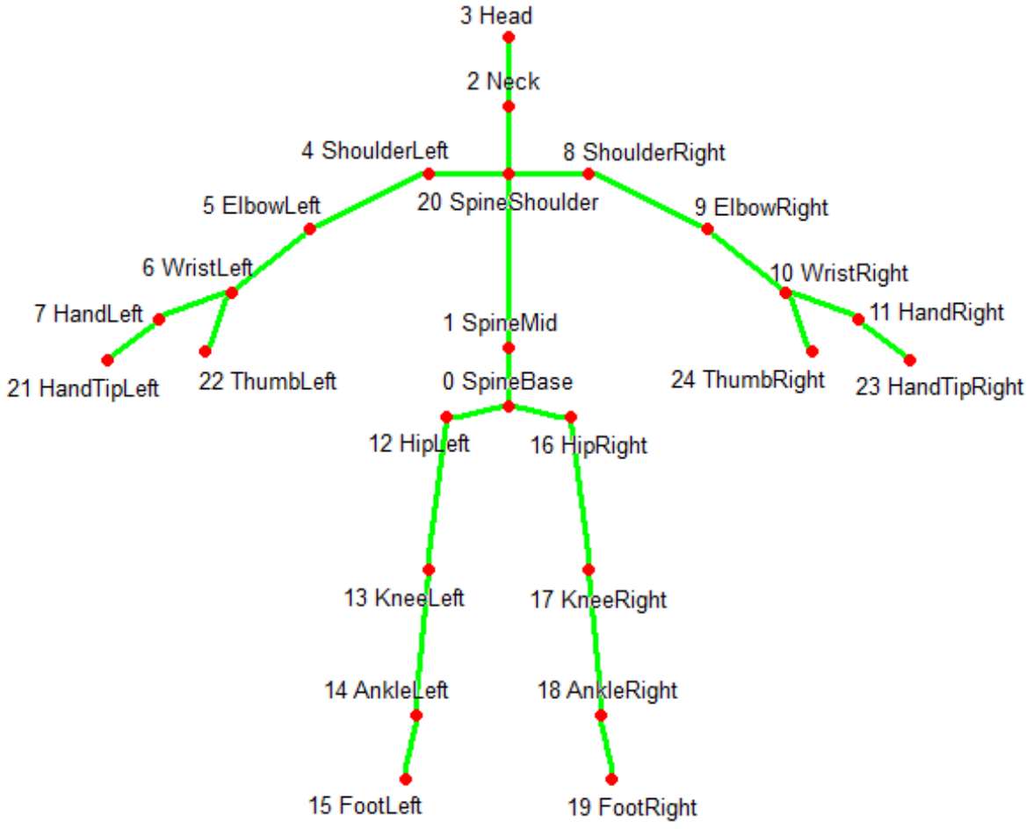
Joints are defined as objects which are compared wrt their relative positioning in Cartesian space.
Help in expressing the higher level relationships.
Joint are then merged into segments.
Figure : The 25 joints of a MS Kinect Skeleton.

Slide 13
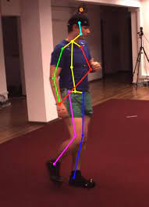
Pose
Comparison between two joints.
Logical constructs for combining poses :-
Merging two poses.
and
&
Matching at least one pose
or
|
Matching the opposite of pose
not
!

Slide 14
Shortest distance between the joints is calculated for maintaining proportion between various differences like difference in height, difference in angle etc.
Limbs are considered as the connecting bones between hips and ankle and, shoulder and wrist and are used for calculation of rotation and angles.
Degree of confidence is calculated from comparing the position of the body found (which is obtained from a Kinect frame) with a pre made model of the pose.

Slide 15
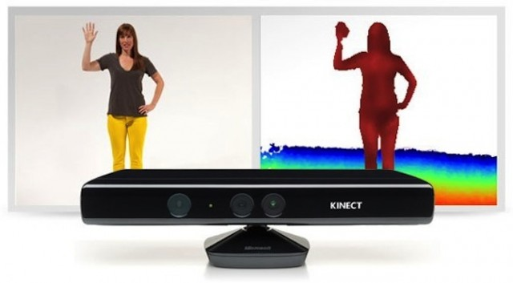
Sensor
The Sensor class is used to identify the user.
Has property of ‘providesData’.

Slide 16
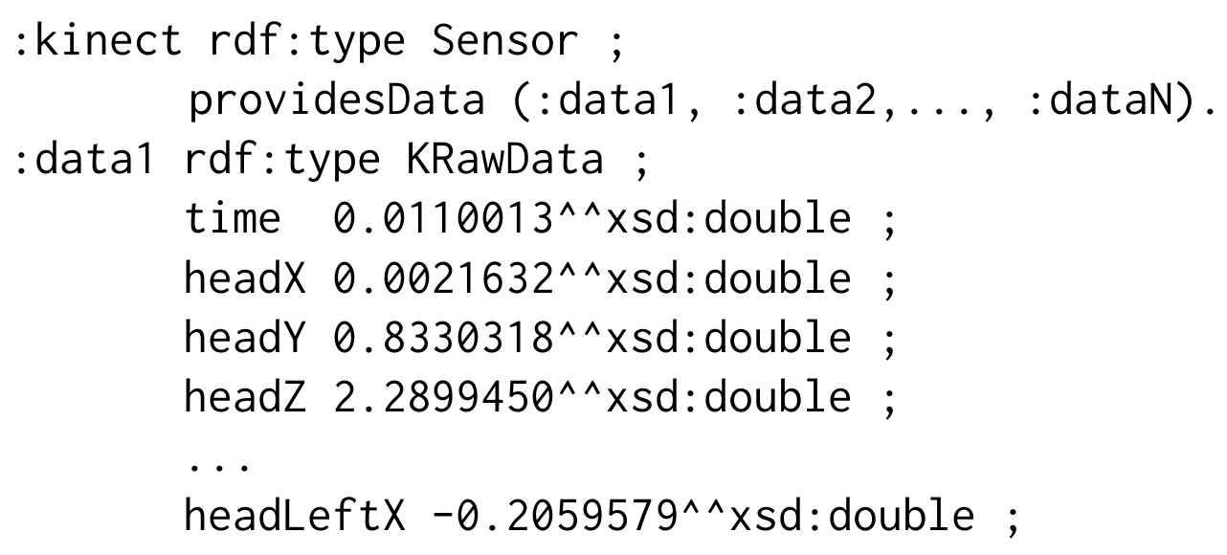
Raw data is expressed by another class called KRawData.
KRawData stores the numerical position of various body parts such as the head, neck, hand etc.
Example -

Slide 17
Other classes
User
Populated by a subset of properties coming from the Person class
Body
Has multiple instances of BodyPart class.
Identified with ‘trackingId’ functional property.
BodyPart
Super class of Limb, Bone, Joint etc.

Slide 18
Conducting the Gesture Elicitation Study (GES)
Referents were selected and divided into 3 groups:
Unary action
Binary action
Linear action
24 voluntary participants were recruited for the GES.
Experiment was conducted in a laboratory. Sheets of paper having the referent written on them were provided to the participants.
Notes:
Referent means the object which is being referred. Ex- Ramesh sees the sun. Suresh sees the sun. So sun is the referent here.

Slide 19
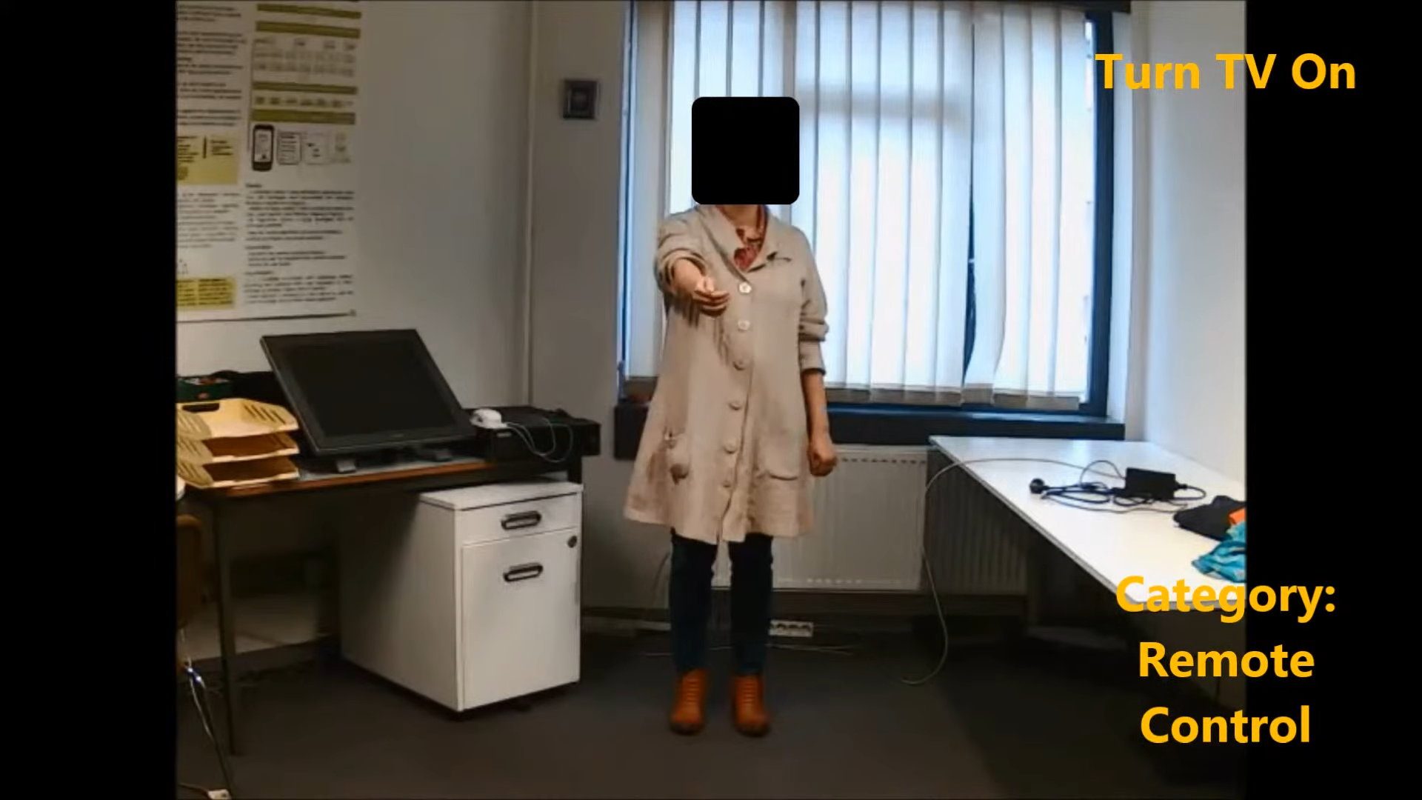
Youtube screenshot of the participant eliciting a gesture

Slide 20
Procedure
Participants signed consent form.
Asked about to fill a questionnaire.
Randomly shuffled before giving to each participant for which they elicited the gestures.
Thinking time and goodness of fit were recorded.
Asked to fill some questionnaire at end again.

Slide 21
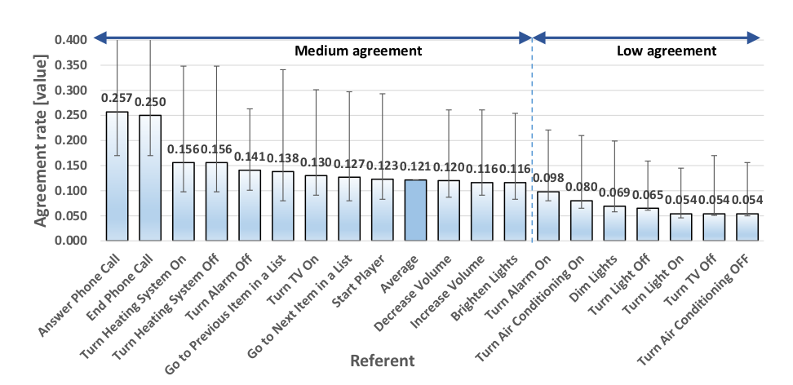
Results
Figure : Referents in decreasing order of their agreement rate. Error bars show a confidence interval for α = .05.

Slide 22
The previous figure depicts the referents in decreasing order of their agreement rate computed.
Overall, agreement scores and rates are medium in average magnitude, in particular for rates (which are the most demanding ones) between .257 and .116 for the global sampling.
Results fall inside medium consensus category with their average in the same interval.

Slide 23
Conclusion
Discussed an ontology for structuring body-based gestures.
Ontology based recognition of Hastha mudras in Bharatanatyam dance can draw a lot of ideas from this experiment’s gesture set.
Ontology provides extensibility.

Slide 24
Future Work
My future work will be to make a Hastha Mudra retrieval system using Ontology.
The input will be search query for the Hastha Mudra and my software will then give all the images or videos containing the queried hastha mudra from the corpus.
For example, we can search for all the videos or images containing the Pataka hastha mudra.

Slide 25
Refrences
[1] Ousmer, Mehdi, Jean Vanderdonckt, and Sabin Buraga. "An ontology for reasoning on body-based gestures." Proceedings of the ACM SIGCHI Symposium on Engineering Interactive Computing Systems. 2019.
[2] Radu-Daniel Vatavu and Jacob O. Wobbrock. 2015. Formalizing Agreement Analysis for Elicitation Studies: New Measures, Significance Test,and Toolkit. In Proc. of CHI ’15. 1325–1334.

Slide 26
Thanks!
You can reach me at
aryan1454@iitkgp.ac.in

